Slide 1
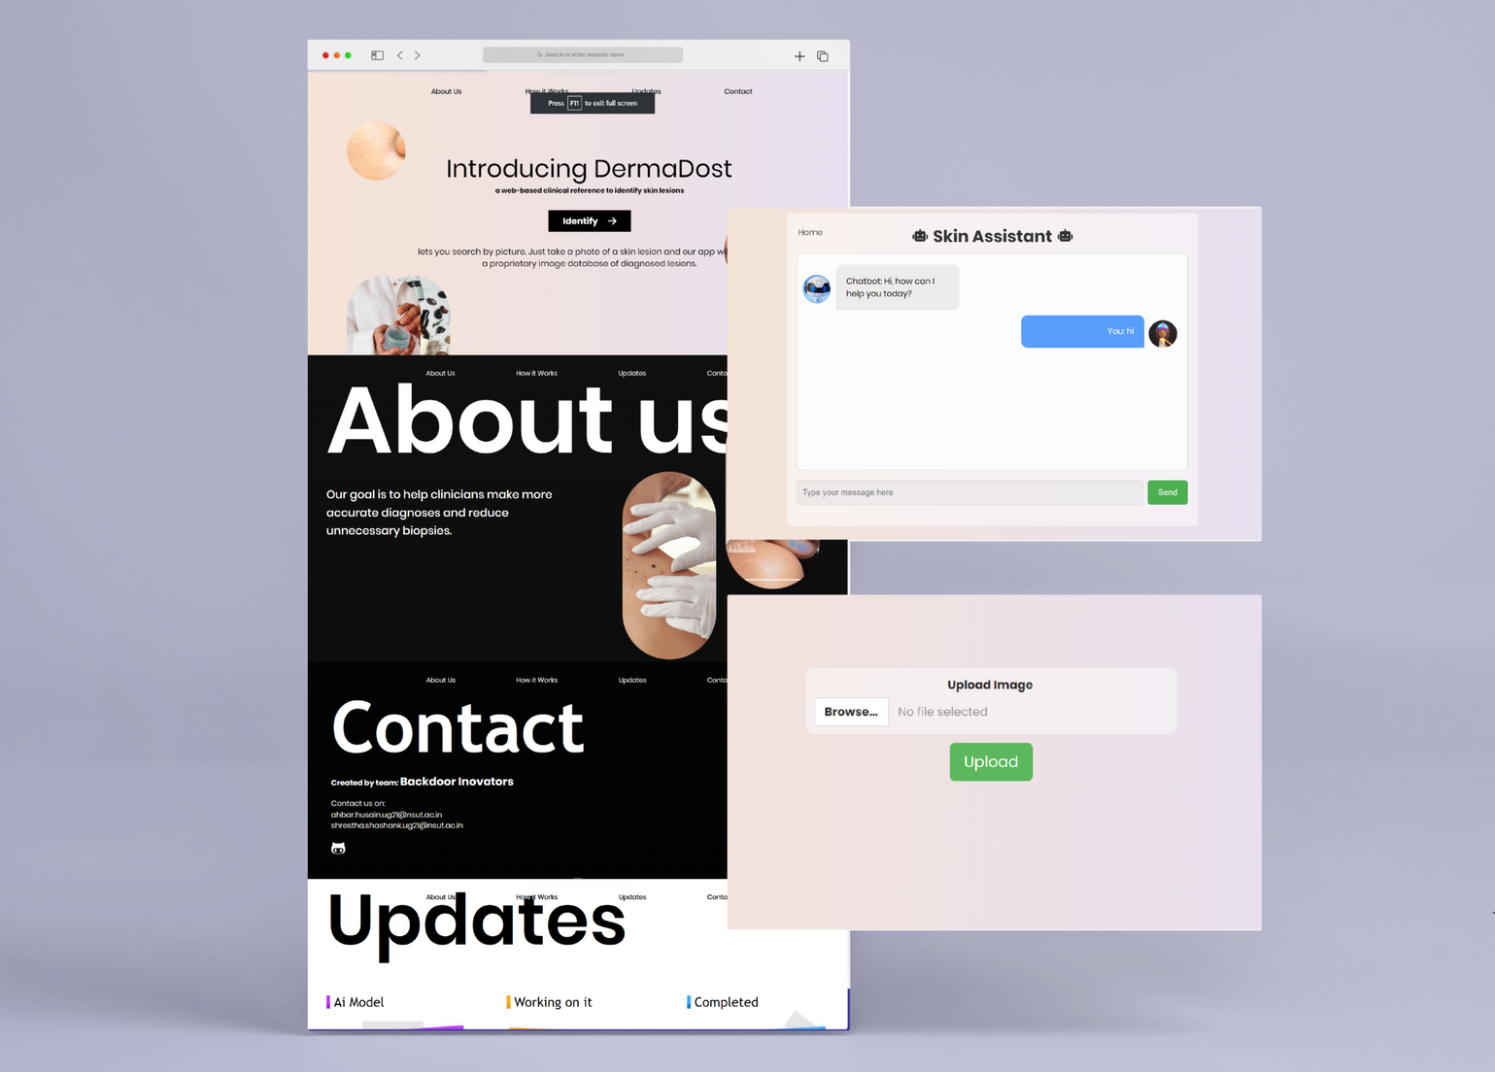
DERMADOST
DermaDost is a prototype web application designed to help users identify various skin conditions and to provide support through a LLM powered skin assistant.

Slide 2





Team CodeFire
AHBAR
HUSAIN
YASH
ARYA

Slide 3




SKIN DISEASES IN INDIA
Skin diseases in India are a major health concern, often leading to severe complications and even fatalities due to delayed diagnosis and limited access to healthcare services. Fungal infections, eczema, psoriasis, and dermatitis are common, exacerbated by factors such as the humid climate and poor hygiene practices.

Slide 4



Skin Disease Detection ,can detect 6 skin diseases along with Pimple detection and segmentation
1
KEY
FEATURES
2
Accuracy of 90% + Trained on more than 6000 skin images
3
Multilingual Skin Care Chatbot for Support
4
Skin Product Analyzer with Skin Care Routine Generator
5
Locate nearby dermatologists seamlessly with secure user data handling

Slide 5

Advantages
1
INCREASED EFFICIENCY
Takes lesser time than when done by humans.
2
EARLY DETECTION
Can help detect Skin Diseases early.
3
IMPROVED ACCURACY
No scope for human error.

Slide 6
Advantages
4
DATA COLLECTION
Can provide valuable data on the prevalence of Skin Diseases, helping healthcare professionals and government.
5
COST SAVINGS
Saves money.
6
AFFORDABLE
Easily affordable by economically weak patients.

Slide 7

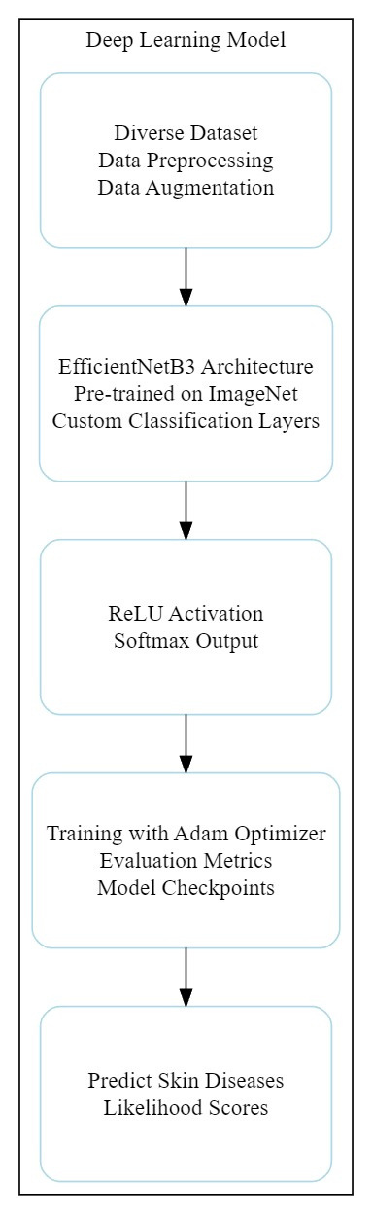
AI/ML MODEL
AI/ML Model
Deep Learning Model:
• 📊Data Preparation: Data augmentation and meticulous preparation for accurate diagnosis.
• 🚀Powered by EfficientNetB3: Leveraging transfer learning for top-tier performance.
• 🧠Custom Classification: Cutting-edge custom classification layers, ReLU activation, and softmax.
• ⚙️Training Excellence: Categorical cross-entropy loss and Adam optimizer for model updates.
• ⭐Rigorous Evaluation: Metrics include accuracy, precision, recall, F1-score, and a confusion matrix.
• 🛡️Model Reliability: Ensured with model checkpoints and Model Checkpoint callbacks

Slide 8
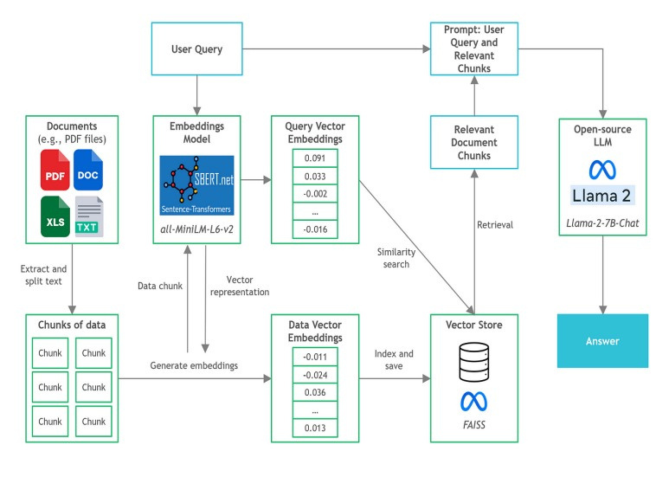
Skin Care Assistant and Support
Skin Care Assistant and Support
Meet the Skin Care Assistant, your expert guide in over 100 languages. It remembers your past chats and responds through both text and audio, making it accessible to people of all ages and abilities.
• 🤖Expert Guidance: A multilingual skincare guide powered by Large Language Model (Llama2).
• 📚Reliable Information: Access to a vector database and authoritative sources like The Ministry of Ayush and Wikipedia.
• 💬Responsive: Quick, accurate, and high-quality responses.
• 💡Contextually Relevant: Efficient question-answering with the RetrievalQA class.

Slide 9
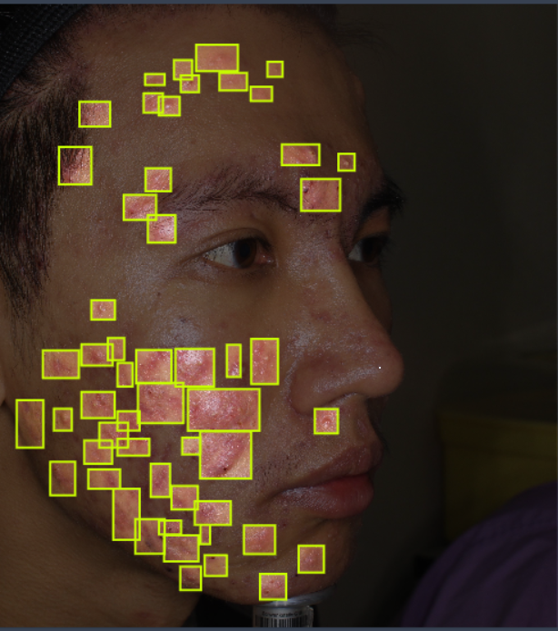
Pimples Detection
Pimple Detection and Segmentation using Computer Vision
4
Trained a robust acne (pimples) detection and instance segmentation model using YOLOv8 in computer vision. The model exhibits high precision, enabling accurate tracking of pimple counts in images.
This tool proves invaluable for monitoring changes in acne presence over time, facilitating efficient analysis of skin conditions.
The achieved precision score reflects the model's reliability in discerning and quantifying individual pimples, providing valuable insights for skincare assessment and improvement.
5
6
mAP@0.5 value of 38.3

Slide 10








TECH STACK
Front-end
HTML, CSS, Javascript
Back-end
Flask
AL/ML Models
Tensorflow,YOLO
Chatbot
Langchain,HuggingFace Lama2

Slide 11
QnA

